Slide 1
Learning with Small Data
Zhenhui Li, Huaxiu Yao, Fenglong Ma
Penn State University
Notes:
https://sites.psu.edu/daml/

Slide 2
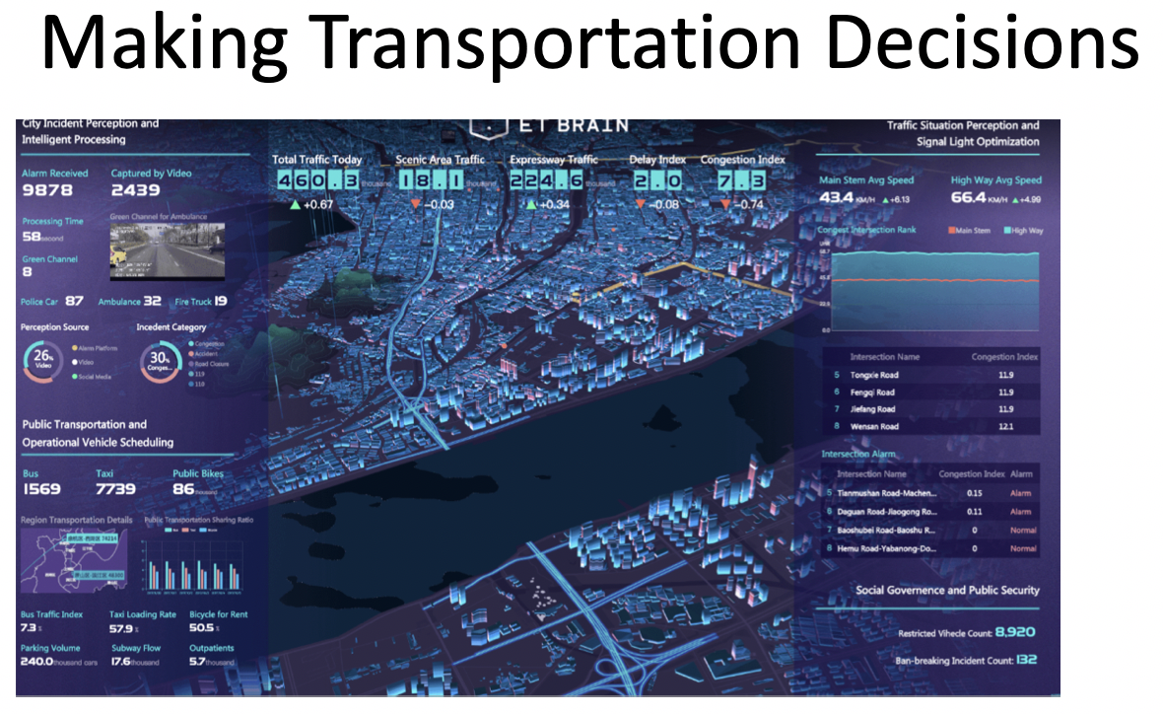
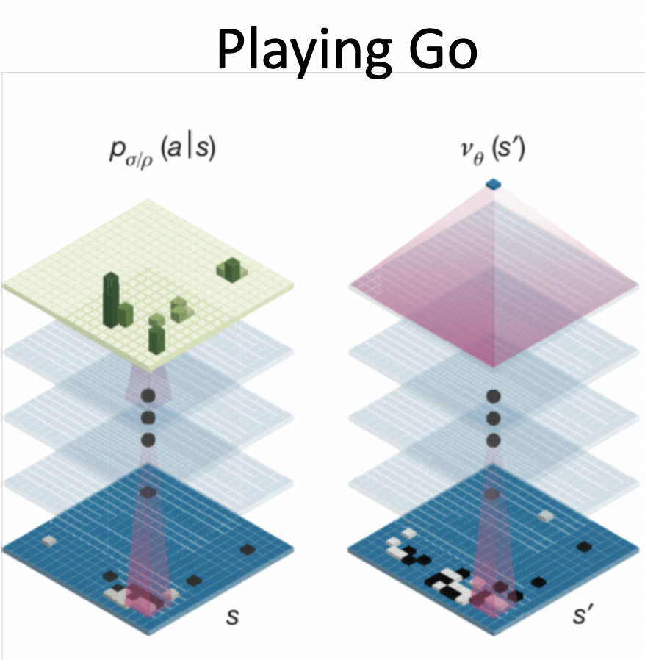
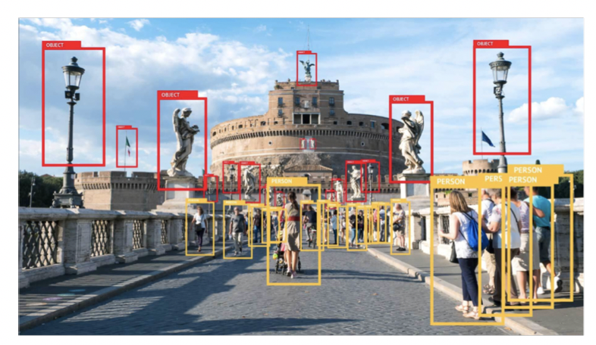
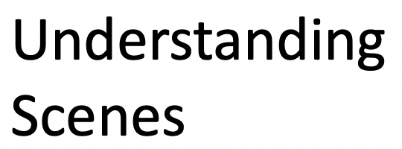
Deep Learning is Everywhere

Slide 3
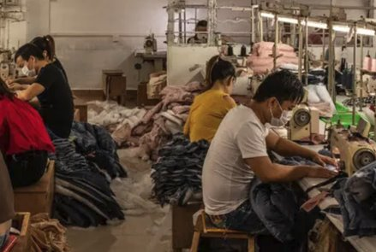
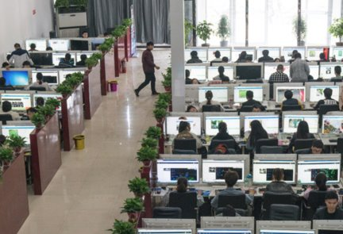
Deep Learning require large data
Factory 1.0: Traditional factory​
Factory 2.0: Data labelling factory​​
Can we learn with small labeled data?

Slide 4
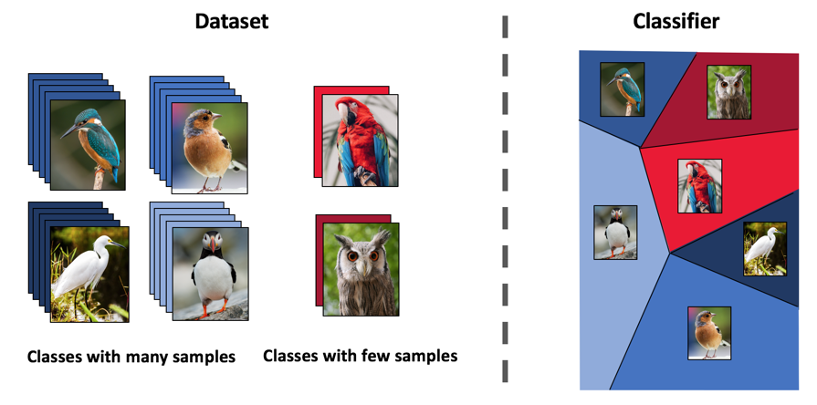
Image classification
https://medium.com/sap-machine-learning-research/deep-few-shot-learning-a1caa289f18

Slide 5
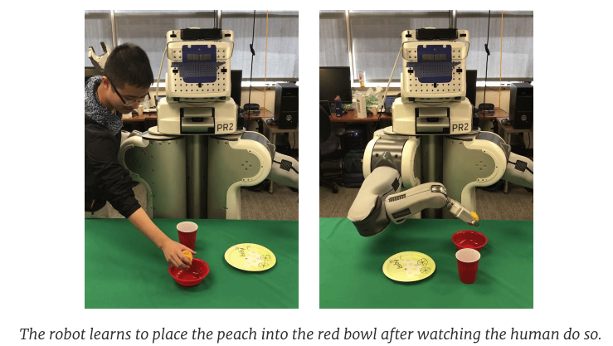
Robot Manipulation
https://bair.berkeley.edu/blog/2018/06/28/daml/

Slide 6
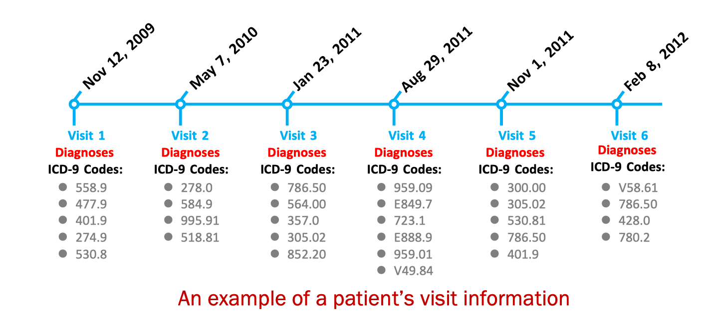
Healthcare Example

Slide 7
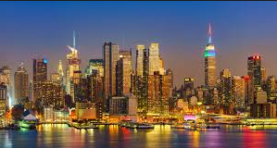
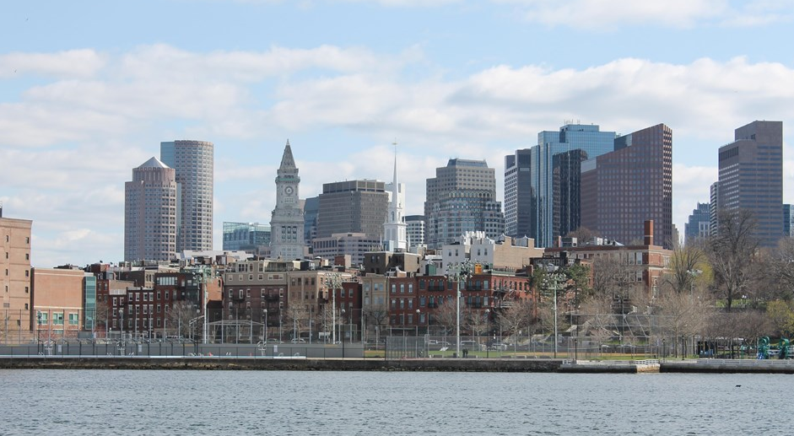
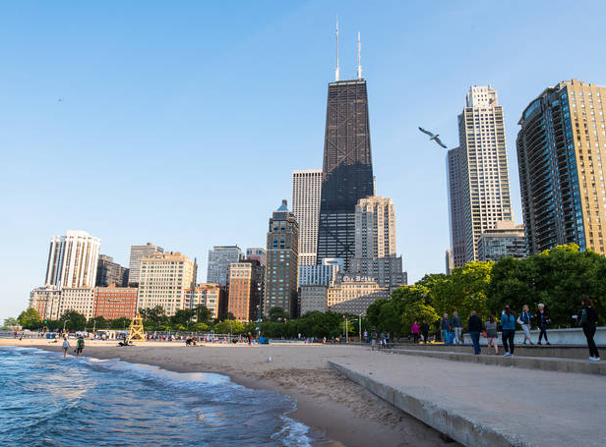
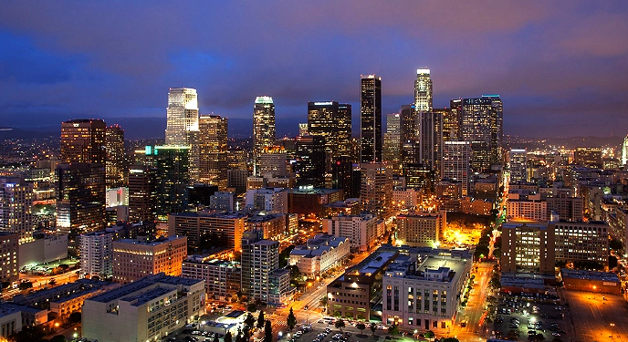
City data prediction example
Many data
Little data
NYC
Chicago
Boston
LA

Slide 8
How to learn with small labeled data
Data-wise
Data Augmentation from labeled/unlabeled data
Model-wise
Transfer & reuse previous learned knowledge
Utilize the extra-knowledge (e.g., domain expert)

Slide 9
Outline
Transfer knowledge from models
Transfer learning
Multi-task learning
Meta-learning
Applications
------ Coffee break ------
Transfer knowledge from domain expert
Enrich representations using knowledge graph
Domain-knowledge driven regularization
Data Augmentation
Augmentation using labeled data
Augmentation using unlabeled data

Slide 10
Outline
Transfer knowledge from models
Transfer learning
Multi-task learning
Meta-learning
Applications
------ Coffee break ------
Transfer knowledge from domain expert
Enrich representations using knowledge graph
Domain-knowledge driven regularization
Data Augmentation
Augmentation using labeled data
Augmentation using unlabeled data

Slide 11
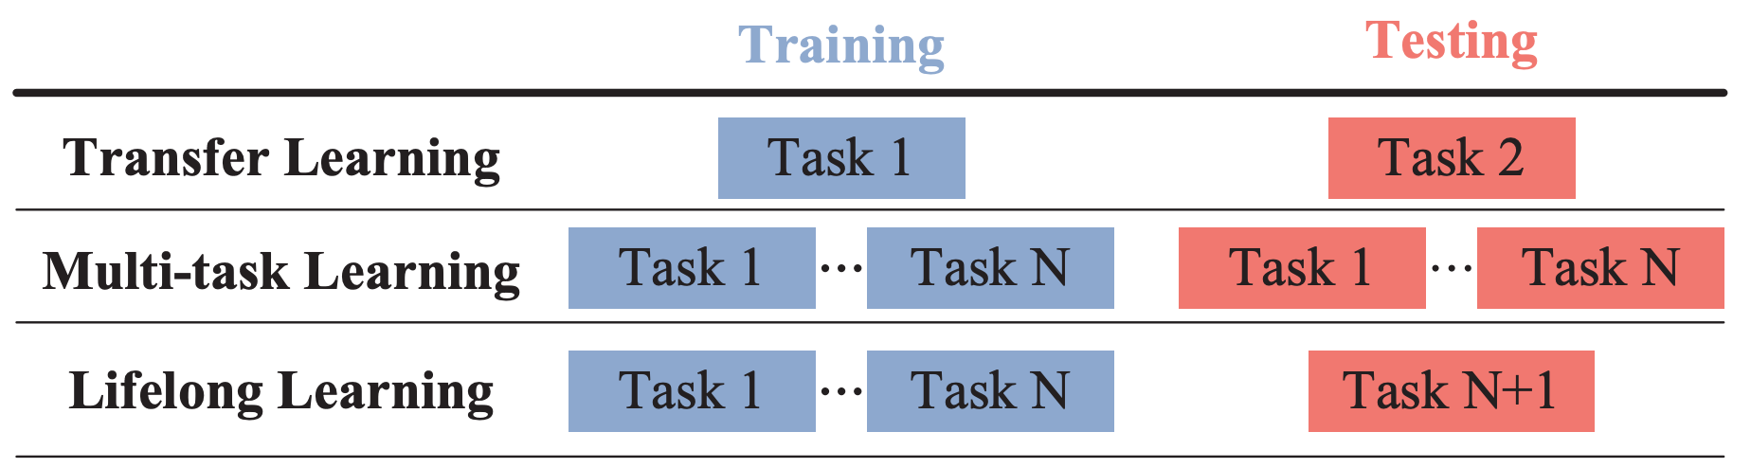
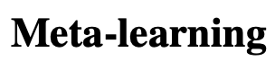
Transfer knowledge from models: Overview
Source
Target

Slide 12
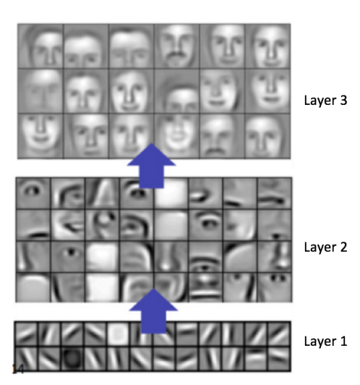
Why we can transfer
In CNN, initial layer filters encode simple features, while later layer filters encode more complex features
Low level features are common across different datasets

Slide 13
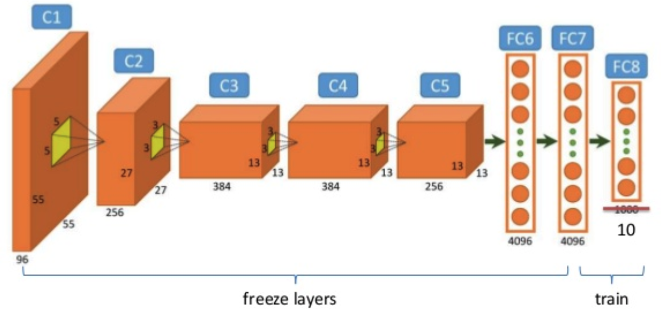
Finetuning
All layers are pre-trained in a large dataset (e.g., ImageNet)
For new dataset, freeze several low-level layers, train the last several layers
https://hackernoon.com/8-deep-learning-best-practices-i-learned-about-in-2017-700f32409512

Slide 14
Outline
Transfer knowledge from models
Transfer learning
Multi-task learning
Meta-learning
Applications
------ Coffee break ------
Transfer knowledge from domain expert
Enrich representations using knowledge graph
Domain-knowledge driven regularization
Data Augmentation
Augmentation using labeled data
Augmentation using unlabeled data

Slide 15
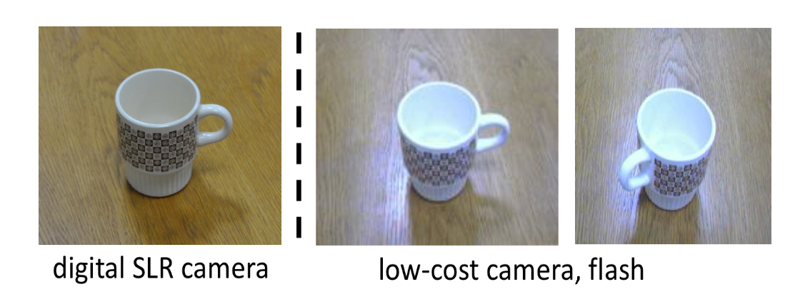
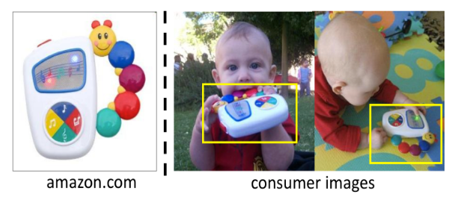
Unsupervised Deep Transfer Learning
Source domain: labeled data
Target domain: unlabeled data
https://people.eecs.berkeley.edu/~jhoffman/domainadapt/#people

Slide 16
Unsupervised Deep Transfer Learning
Goal: learn a classifier or a regressor for a target domain which is unlabeled and dissimilar to a source domain.
General architecture: Siamese architecture
Tied layers: share weight by source and target domains
adaptation layers: domain specific layers (no weight sharing)
tied layers
adaptation layers
source classifier
source input
domain distance minimization
target input

Slide 17
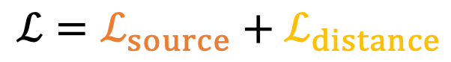
Unsupervised Deep Transfer Learning
$$ℒ=ℒ_{source}+ℒ_{distance}$$
tied layers
adaptation layers
source classifier
source input
domain distance minimization
target input

Slide 18
Unsupervised Deep Transfer Learning
$$ℒ=ℒ_{source}+ℒ_{distance}$$
tied layers
adaptation layers
source classifier
source input
domain distance minimization
target input

Slide 19
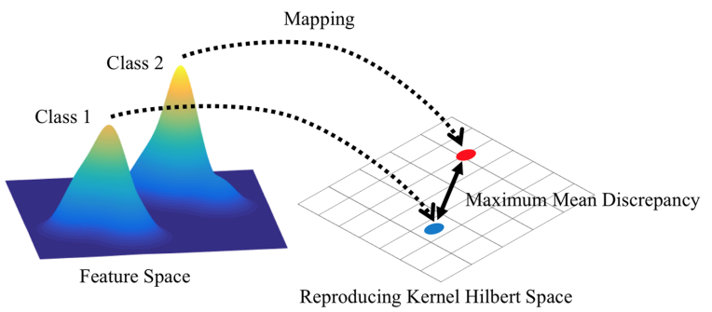
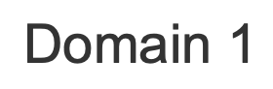
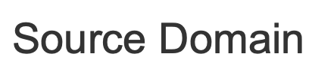
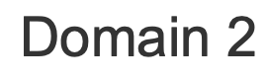
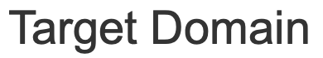
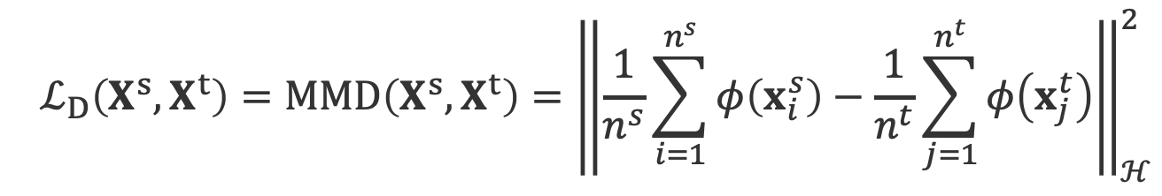
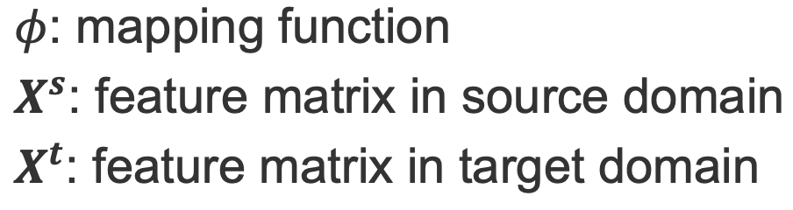
Discrepancy-based method
MMD: maximum mean discrepancy
The distance of distributions is defined as MMD

Slide 20
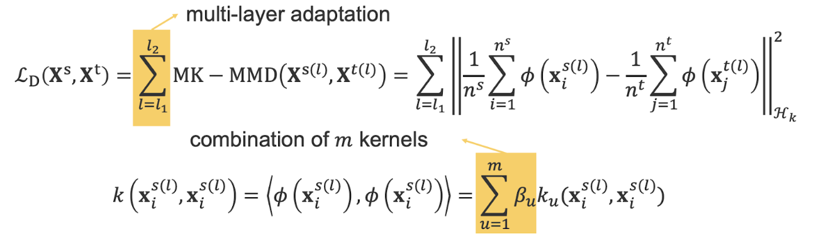
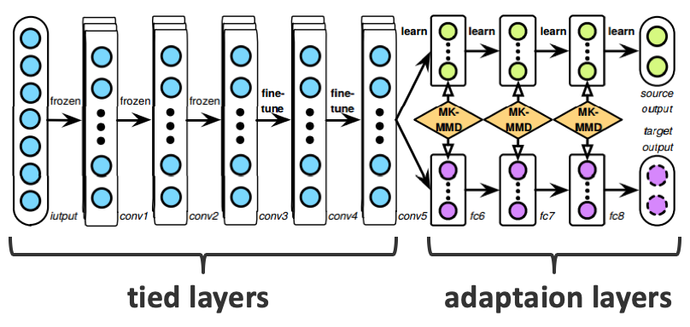
Deep Adaptation Network
[Long et al. Learning Transferable Features with Deep Adaptation Networks ICML’15]

Slide 21
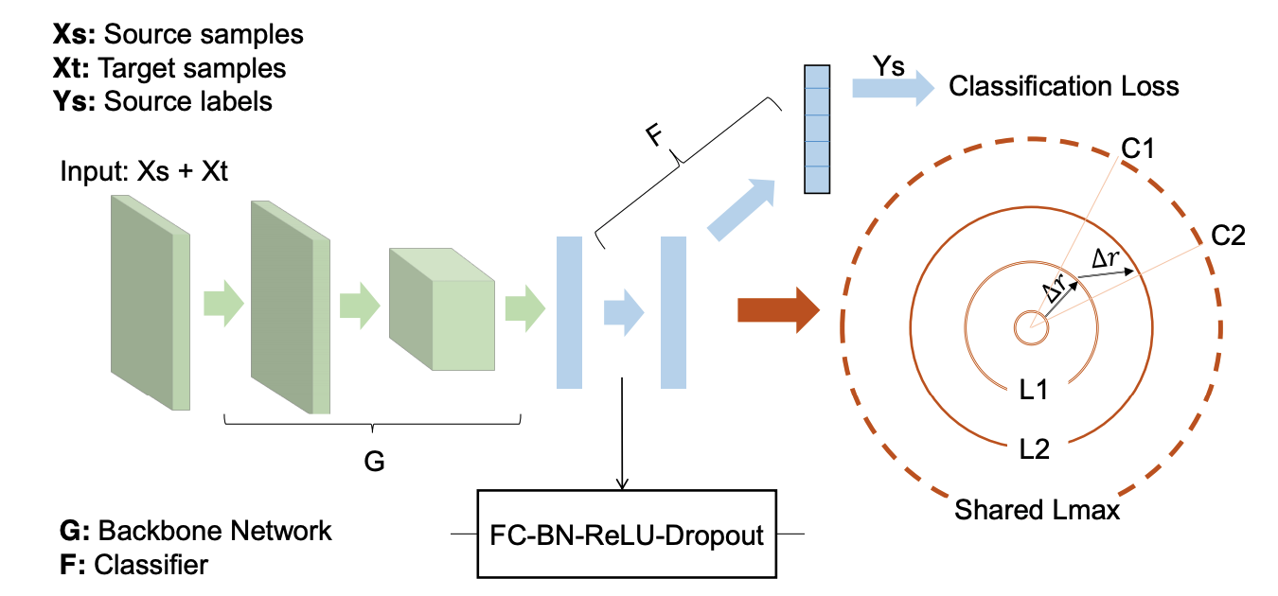
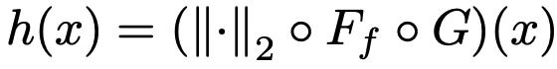
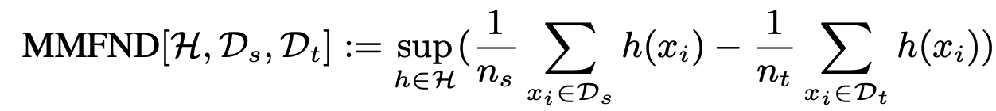
Hard Adaptive Feature Norm (HAFN)
[Xu et al. Larger Norm More Transferable: An Adaptive Feature Norm Approach for Unsupervised Domain Adaptation ICCV’19]

Slide 22
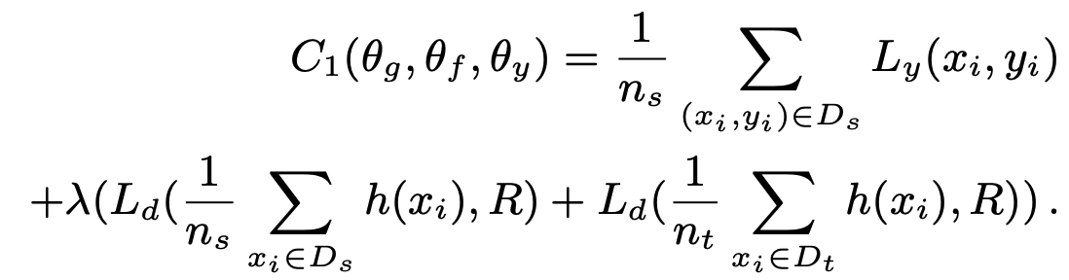
Hard Adaptive Feature Norm (HAFN)
[Xu et al. Larger Norm More Transferable: An Adaptive Feature Norm Approach for Unsupervised Domain Adaptation ICCV’19]
Notes:
Feature norm radius; upper bound will greatly deviate from zero-> constraint of the h(x) value

Slide 23
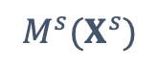
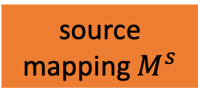
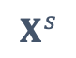
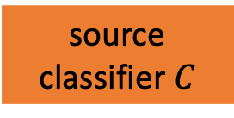

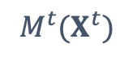
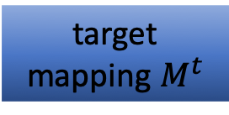
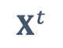
Adversarial method
Unified view of adversarial unsupervised domain adaptation
source classifier $C$
source input
$$X^{s}$$
source mapping $M^{s}$
$$M^{s}(X^{s})$$
generative or discriminative model?
weights shared or not?
which type of adversarial loss
Discriminator $D$
target input
target mapping $M^{t}$
$$X^{t}$$
$$M^{t}(X^{t})$$

Slide 24
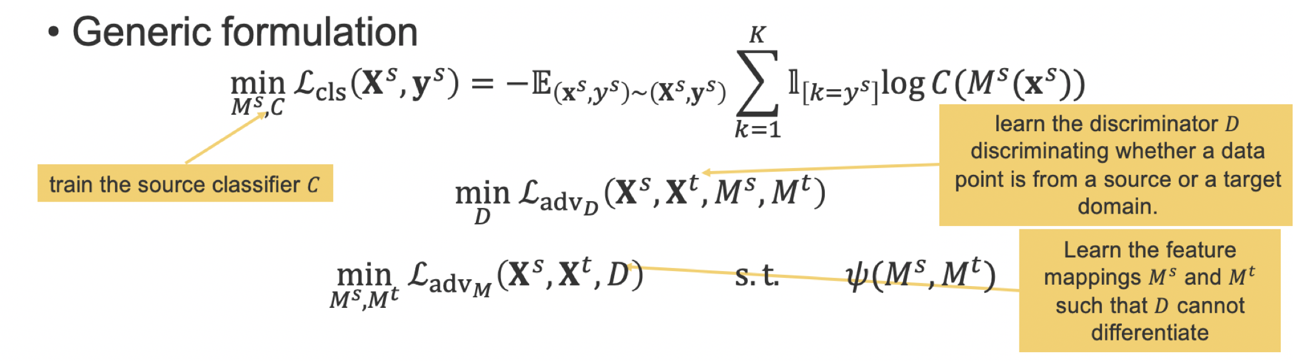
Adversarial method
[Tzeng et al. 2015 Deep Domain Confusion: Maximizing for Domain Invariance
Tzeng et al. 2016 ADDA
Liu et al. 2016 Coupled GANs]

Slide 25
Outline
Transfer knowledge from models
Transfer learning
Multi-task learning
Meta-learning
Applications
------ Coffee break ------
Transfer knowledge from domain expert
Enrich representations using knowledge graph
Domain-knowledge driven regularization
Data Augmentation
Augmentation using labeled data
Augmentation using unlabeled data

Slide 26
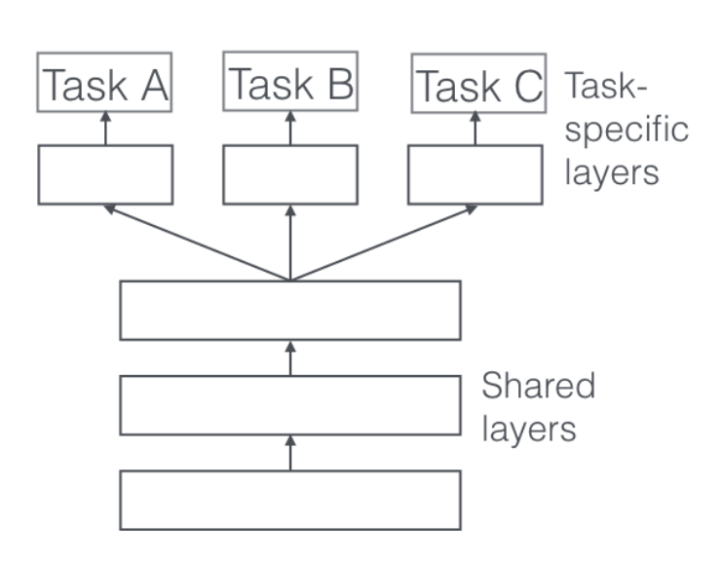
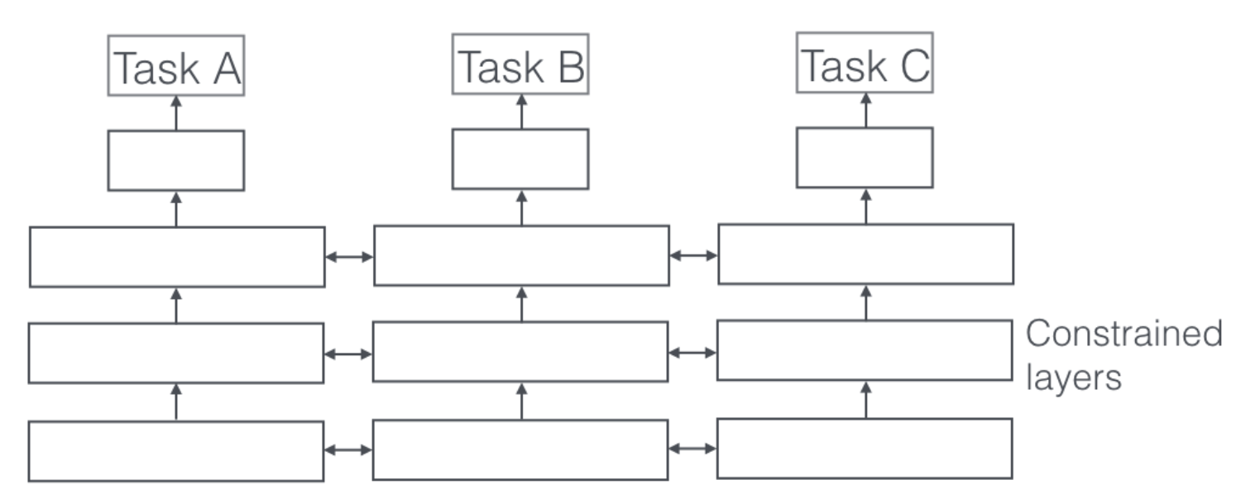
Multi-task Learning
Hard parameter sharing
Soft parameter sharing
Different tasks share the information in low layers
Is there more flexible way to incorporate task information?
https://ruder.io/multi-task/index.html#ajointmanytaskmodel

Slide 27
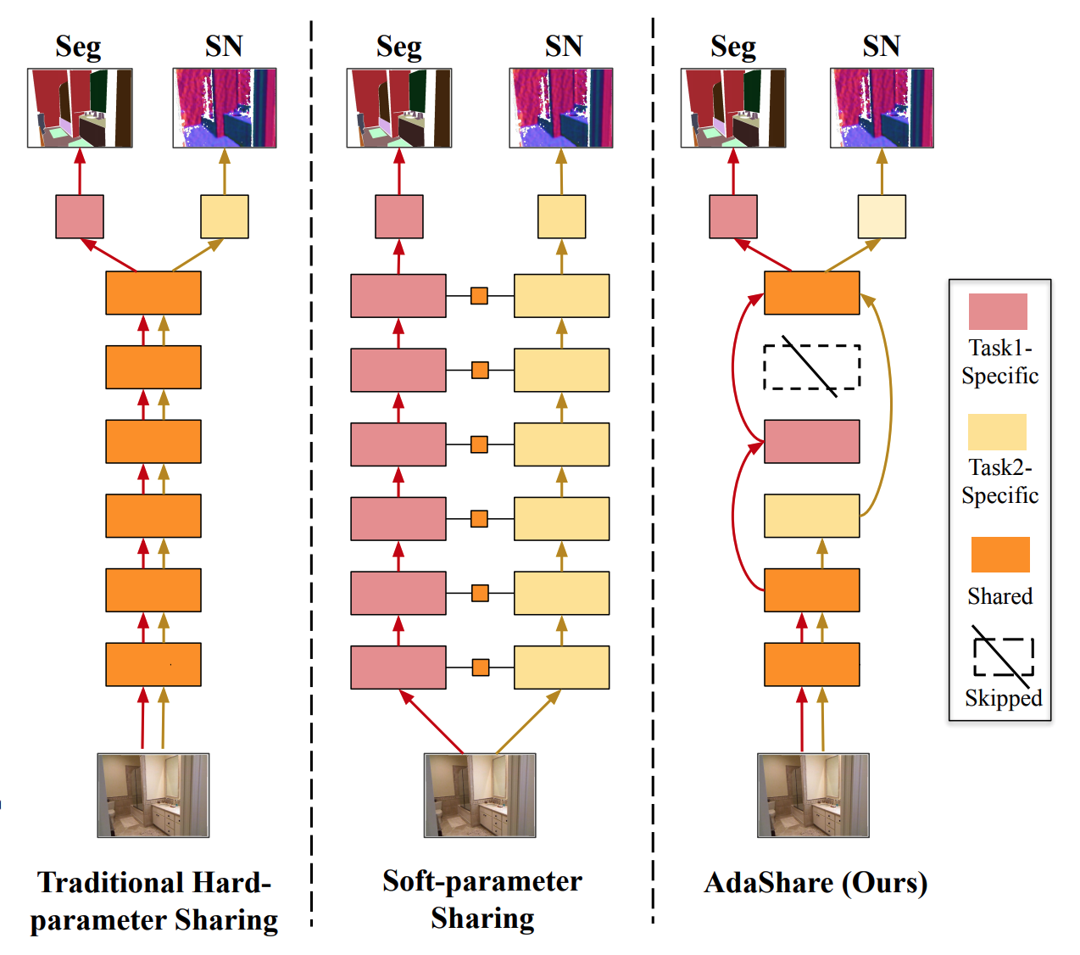
Multi-task Learning with layer selection
Decide what to share across which tasks
[Sun et al. arXiv: 1911.12423]

Slide 28
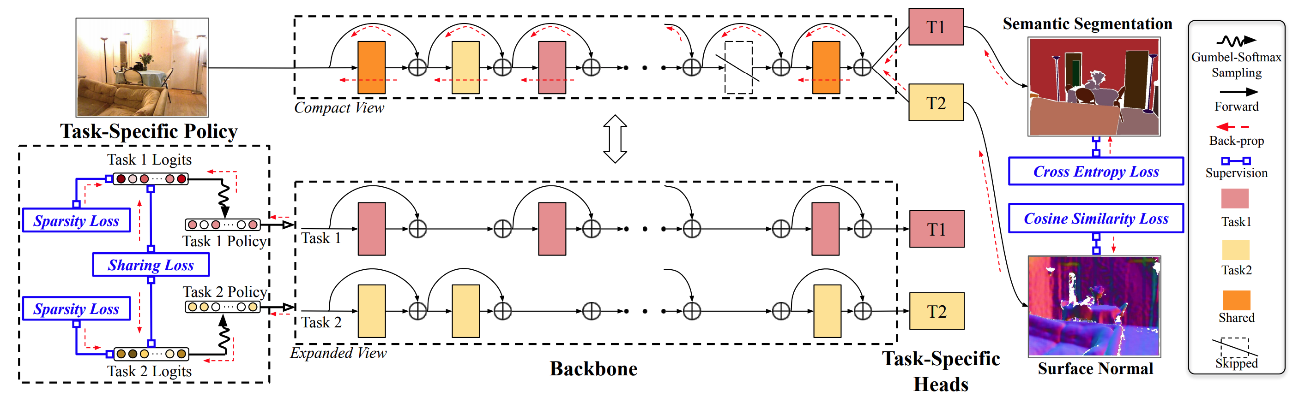
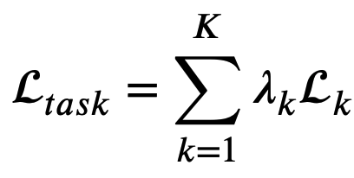
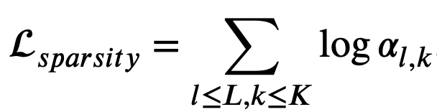
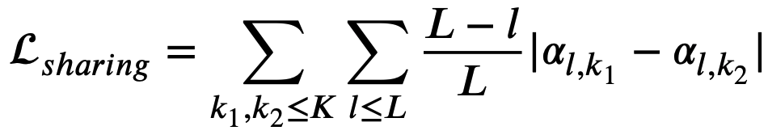
Multi-task Learning with layer selection
[Sun et al. arXiv: 1911.12423]

Slide 29
Outline
Transfer knowledge from models
Transfer learning
Multi-task learning
Meta-learning
Applications
------ Coffee break ------
Transfer knowledge from domain expert
Enrich representations using knowledge graph
Domain-knowledge driven regularization
Data Augmentation
Augmentation using labeled data
Augmentation using unlabeled data

Slide 30
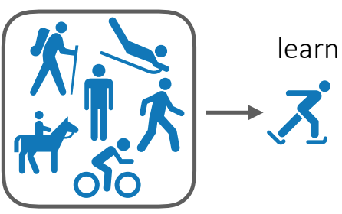
Meta-learning
Learn and summarize
Learn a prior from a lot of tasks
Reuse the learned knowledge to facilitate the learning process of a new unseen task
Meta-learning = learning to learn
Finn ICML Tutorial 2019
Notes:
Add more slides

Slide 31
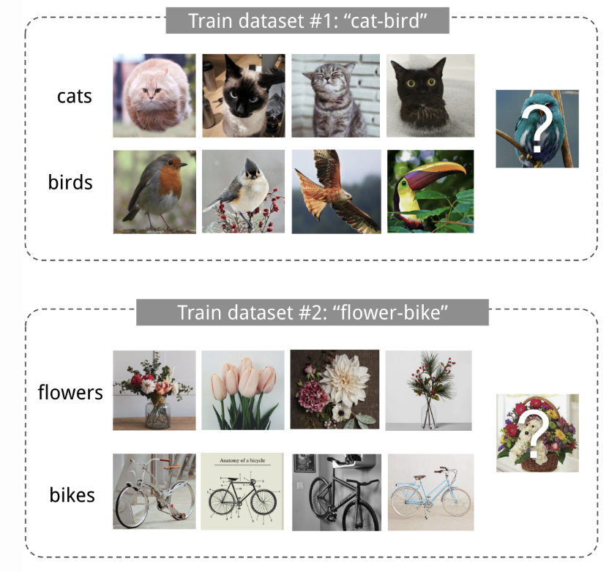

Example
Meta-training
Meta-testing
Prior
https://lilianweng.github.io/lil-log/2018/11/30/meta-learning.html

Slide 32
Difference between Transfer, Multi-task & Meta-learning
Transfer Learning
Care about the performance on target task
Training data of target tasks may used in training process
Meta-learning
Care about the learned experience from previous tasks, which can be used in both trained tasks and new task
No training data from target domain used in training process
Multi-task Learning
Both training and testing data are from same domains
Source tasks must trained together with target tasks

Slide 33

Meta-learning: Problem Formulation
https://ai.stanford.edu/~cbfinn/_files/metalearning_frontiers_2018_small.pdf

Slide 34



Meta-learning: Gradient-based Method
Meta-training
Meta-testing
Model-Agnostic Meta-Learning (MAML)
[Finn et al. Model-Agnostic Meta-Learning for Fast Adaptation of Deep Networks ICML’17]

Slide 35





Variants of MAML
Idea: pre-conditioning of gradient
MAML [Finn et al. ICML’17]
MetaSGD [Li et al. arXiv’16]
T-net [Lee et al. ICML’18]
Wrap-grad [Flennerhag et al. ICLR’20]

Slide 36




Variants of MAML
First-order MAML
FOMAML [Finn et al. ICML’17]:
Reptile [Nichol et al. arXiv 18]:
MAML with proximal [Rajeswaran et al. NeurIPS’19 iMAML; Zhou et al. NeurIPS’19 Meta-MinibatchProx]

Slide 37


Meta-learning: Non-parametric Methods
https://drive.google.com/file/d/1DuHyotdwEAEhmuHQWwRosdiVBVGm8uYx/view

Slide 38



Matching Network
Meta-training: learn the embedding functions $g_{θ}$ and $f_{θ}$
Meta-testing: forward the network -> 1-NN
If >1 shot, how to solve this problem?
[Vinyals et al. Matching Network for One-shot Learning NeurIPS’16]

Slide 39



Prototypical Network
Aggregate samples embeddings within each class
Learn the mapping function
[Snell et al. Prototypical Networks for Few-shot Learning NeurIPS’17]

Slide 40
Comparison
Gradient-based Methods
handles different problems (regression, classification, reinforcement learning)
- computational expensive
Non-parametric Methods
Simple and entirely feed forward
- depends on the distance metric
limited to classification

Slide 41
Challenge
Is task specific model enough?
New Task
Learned knowledge
Organized knowledge
Reuse knowledge

Slide 42







Human Beings: Knowledge Organization and Reuse
store play
market
reading
Gershman, Samuel J., David M. Blei, and Yael Niv. "Context, learning, and extinction." Psychological review 117.1 (2010): 197.
Gershman, Samuel J., et al. "Statistical computations underlying the dynamics of memory updating." PLoS computational biology 10.11 (2014): e1003939.

Slide 43

Hierarchically Structured Meta-learning (HSML)
Balance between generalization and customization
Organize tasks by hierarchical clustering
Adapt the global initialization to each cluster of tasks
[Yao et al. Hierarchically Structured Meta-learning ICML’19]

Slide 44





HSML: Task Representation Learning
Mean pooling auto-encoder aggregator
Recurrent auto-encoder aggregator
Reconstruction loss for training the autoencoder
[Yao et al. Hierarchically Structured Meta-learning ICML’19]

Slide 45


HSML: Hierarchical Task Clustering
Assignment step: softly assign a task to the nearest cluster
Update step: update the representation of a cluster
[Yao et al. Hierarchically Structured Meta-learning ICML’19]

Slide 46



HSML: Knowledge Adaptation
Establish a cluster-specific parameter gate
Adapt the global initialization with the cluster-specific gate
Overall optimization problem
[Yao et al. Hierarchically Structured Meta-learning ICML’19]

Slide 47






Qualitive analysis
Cluster assignment interpretation
4 sync family functions
Sin
Line
Cubic
Quadratic
Base Learner: two layers fully connected layers
[Yao et al. Hierarchically Structured Meta-learning ICML’19]
Notes:
Add the definition for family function

Slide 48

Qualitive analysis
Cluster assignment interpretation
4 sync family functions—Sin, Line, Cubic, Quadratic
K-shot: K samples are used as training (each task)
[Yao et al. Hierarchically Structured Meta-learning ICML’19]

Slide 49
From cluster to meta-knowledge graph
Graph structure
Math
Physics
Chinese
Algebra
Geometry
Analysis
Electromagnetism
Poem
Writing

Slide 50
From cluster to meta-knowledge graph
Graph structure
Math
Physics
Chinese
Algebra
Geometry
Analysis
Electromagnetism
Poem
Writing

Slide 51

Automated Relational Meta-learning (ARML)
Automatically learn the structure
Structuring samples as prototype-based graph
Query the meta-knowledge graph for historical information
[Yao et al. Automated Relational Meta-learning ICLR’20]

Slide 52

ARML: Prototypical Relational Graph
Prototype -> sample-level cluster
[Yao et al. Automated Relational Meta-learning ICLR’20]

Slide 53




ARML: Meta-knowledge Graph Propagation
Meta-knowledge Graph $𝒢$
Prototype-based Relational Structure $ℛ_{i}$
Propagation
[Yao et al. Automated Relational Meta-learning ICLR’20]

Slide 54
ARML: Information Adaptation
Two autoencoder aggregators:
Aggregate raw prototype information
Aggregate prototype representations after absorbing the relevant knowledge from the meta-knowledge graph
[Yao et al. Automated Relational Meta-learning ICLR’20]

Slide 55
More task-specific meta-learning models
Idea: Task conditioning:
Vuorio et al. Multimodal Model-Agnostic Meta-Learning via Task-Aware Modulation NeurIPS’19
Oreshkin et al. TADAM: Task dependent adaptive metric for improved few-shot learning NeurIPS’18
Idea: MAML+ Dirichlet process mixture
Jerfel et al. Reconciling meta-learning and continual learning with online mixtures of tasks NeurIPS’19
Yoon et al. Bayesian Model Agnostic Meta-learning NeurIPS’18

Slide 56

What meta-learning really learn?
Rapid Adaptation v.s. Feature Reusing
[Raghu et al. Rapid Learning or Feature Reuse? Towards Understanding the Effectiveness of MAML ICLR’20]

Slide 57

Similarity before & after finetune
[Raghu et al. Rapid Learning or Feature Reuse? Towards Understanding the Effectiveness of MAML ICLR’20]

Slide 58

ANIL
[Raghu et al. Rapid Learning or Feature Reuse? Towards Understanding the Effectiveness of MAML ICLR’20]

Slide 59
Challenges & Discussion
Meta-overfitting (Yin et al. ICLR’20; Hsu et al. ICLR’19)
Overfit the meta-training task distribution
Improve Out-of-domain generalization
Online Meta-learning (preliminary work: Finn et al. ICML’19)
Continually update the meta-learner
Imbalance task distribution
Sample/class imbalance
Fast adaptation

Slide 60
Outline
Transfer knowledge from models
Transfer learning
Multi-task learning
Meta-learning
Applications
------ Coffee break ------
Transfer knowledge from domain expert
Enrich representations using knowledge graph
Domain-knowledge driven regularization
Data Augmentation
Augmentation using labeled data
Augmentation using unlabeled data

Slide 61

Applications in Graph
Graph semi-supervised learning
Similar structured graphs exist everyday
E.g., Wechat group (user profile)
How to exploit the learned experience for node classification?
http://www.pandaguides.com/features/how_to_create_a_wechat_group.html
[Yao et al. Graph Few-shot Learning via Knowledge Transfer AAAI’20]

Slide 62

Graph Few-shot Learning (GFL)
Consider both graph-level and node-level Similarity
Graph-specific gate
Node-specific prototype
[Yao et al. Graph Few-shot Learning via Knowledge Transfer AAAI’20]

Slide 63



GFL: Graph Structured Prototype
Global homogeneous information
Relation construction
Prototype construction
[Yao et al. Graph Few-shot Learning via Knowledge Transfer AAAI’20]

Slide 64



GFL: Hierarchical Graph Representation Gate
Hierarchical graph representation gate
Framework
[Yao et al. Graph Few-shot Learning via Knowledge Transfer AAAI’20]

Slide 65
Applications in Spatiotemporal Prediction
Transfer one city to another -> unstable results/risk of negative transfer
Extract information from multiple cities
Transfer
NYC
Chicago
Boston
LA
[Yao et al. Learning from Multiple Cities: A Meta-Learning Approach for Spatial-Temporal Prediction WWW’19]

Slide 66



Spatiotemporal Prediction Problem
Problem: Given historical spatiotemporal value, predict spatiotemporal value in the next timestamp
?
9:00 AM
10:00 AM
11:00 AM
[Yao et al. Learning from Multiple Cities: A Meta-Learning Approach for Spatial-Temporal Prediction WWW’19]

Slide 67



Base learner – ST-net
A combination of CNN and LSTM
CNN – spatial information
LSTM – temporal dynamics
Time
LSTM
LSTM
LSTM
FC
CNN
CNN
CNN
[Yao et al. Learning from Multiple Cities: A Meta-Learning Approach for Spatial-Temporal Prediction WWW’19]

Slide 68

Challenge: Spatiotemporal Semantic Structure
Semantic Patterns
Long-term patterns
Global property
Hard to be captured with
limited data
Holidays
Missing value
Distill long-period patterns from source cities?
[Yao et al. Learning from Multiple Cities: A Meta-Learning Approach for Spatial-Temporal Prediction WWW’19]

Slide 69


Global Spatial-temporal Memory
Long-term information is encrypted in a memory by clustered patterns
Cross-entropy loss:
[Yao et al. Learning from Multiple Cities: A Meta-Learning Approach for Spatial-Temporal Prediction WWW’19]

Slide 70


Framework: MetaST
Training Loss function:
[Yao et al. Learning from Multiple Cities: A Meta-Learning Approach for Spatial-Temporal Prediction WWW’19]

Slide 71



Patten Analysis for Traffic Prediction
Qualitative results
Pattern assignment interpretation
[Yao et al. Learning from Multiple Cities: A Meta-Learning Approach for Spatial-Temporal Prediction WWW’19]

Slide 72
Outline
Transfer knowledge from models
Transfer learning
Multi-task learning
Meta-learning
Applications
------ Coffee break ------
Transfer knowledge from domain expert
Enrich representations using knowledge graph
Domain-knowledge driven regularization
Data Augmentation
Augmentation using labeled data
Augmentation using unlabeled data

Slide 73
Outline
Transfer knowledge from models
Transfer learning
Multi-task learning
Meta-learning
Applications
------ Coffee break ------
Transfer knowledge from domain expert
Enrich representations using knowledge graph
Domain-knowledge driven regularization
Data Augmentation
Augmentation using labeled data
Augmentation using unlabeled data

Slide 74


Representations of Data
Encode semantic “knowledge” of data in latent space
Map input to latent space. Nonlinear projections
Make classification task easier
source: https://colah.github.io/posts/2015-01-Visualizing-Representations/

Slide 75

Word Embeddings from Scratch
Context word
The quick brown fox jumped over the lazy dog
Input word
King - Man + Woman = Queen
source: https://www.tensorflow.org/tutorials/representation/word2vec

Slide 76
Problems?
Solutions?
Learn everything about the words from scratch
Typically require massive amounts of data
100B word Google News corpus
Humans have lots of knowledge about what words mean and how they interact with other words
Key Idea: How can we use structured information found in secondary data sets to solve interesting problems?
Two examples of how to “enrich” the data representation learned by a model with structured information

Slide 77


ConceptNet: Structured Information for Words
http://conceptnet.io/

Slide 78






Retrofitting
$α_{i}=0:$ new word
$q_{i}:$learned embedding vector
${\hat{q}}_{i}:$existing embedding vector
$E:$edges of ConceptNet graph
$β_{ij}:$ConceptNet edge weight
Adjusts the values of an existing embedding through an new objective that accounts for the knowledge graph
Minimize distance between new vector, and original embedding vector
Also, minimize distance between new vector and learned vectors of neighbors on graph
[Faruqui et al. NAACL’15]

Slide 79



ConceptNet Numberbatch
Retrofitting
Word2vec embeddings
W
+
SVD
GloVe embeddings
G
[Speer et al. AAAI’17]

Slide 80
Benefits of ConceptNet Numberbatch
Leverage information from multiple embedding sources
Don’t need to access underlying data
Utilize a human-curated knowledge graph
Can be very useful for variety of tasks

Slide 81

Healthcare Diagnosis Prediction
Problem Definition
Medical codes
Goal: Predict the diagnosis of a patient’s future visit
Input: A patient’s electronic health record (EHR) over time
Input Data
Prediction
International Classification of Diseases (ICD)

Slide 82


RNN+Attention for Diagnosis Prediction
Training RNN-based models requires large amounts of data.
Medical codes of rare diseases may not learn correct embeddings.
Choi et al. RETAIN: An Interpretable Predictive model for Healthcare Using Reverse Time Attention Mechanism. In NIPS’16.
Ma et al. Dipole: Diagnosis Prediction in Healthcare via Attention-based Bidirectional Recurrent Neural Networks. In KDD’17.

Slide 83

Knowledge Graph-based Diagnosis Prediction
GRAM: Graph-based Attention Model
~25%
Medical ontology information is only used when learning code representations, which does not explicitly affect the final predictions.
Choi et al. GRAM: Graph-based Attention Model for Healthcare Representation Learning. In KDD’17.

Slide 84

KAME: Knowledge-based Attention for Medical Diagnosis
Embed individual medical codes, M, and ancestor codes, A via GRAM
Input M to RNN. Input A, h_{t} to attention mechanism
Knowledge vector, k_{t,} incorporates:
- the patient’s visit history, via h_{t}
- high-level medical knowledge, via L_{t}
Ma et al. KAME: Knowledge-based Attention Model for Diagnosis Prediction in Healthcare. In CIKM’18.

Slide 85

Knowledge Graph-based Diagnosis Prediction
KAME: Knowledge-based Attention Model
KAME is the generalization of the state-of-the-art diagnosis prediction model GRAM.
When removing the proposed knowledge-based attention component (i.e., deleting $k_{t}$), then the proposed KAME is reduced to GRAM.
Ma et al. KAME: Knowledge-based Attention Model for Diagnosis Prediction in Healthcare. In CIKM’18.

Slide 86
Recap: Enriching Representations with Knowledge Graphs
Key Ideas:
We can incorporate domain knowledge into a model with knowledge graphs
Knowledge graph helps better represent data for task
Looked at two examples: NLP and healthcare

Slide 87
Outline
Transfer knowledge from models
Transfer learning
Multi-task learning
Meta-learning
Applications
------ Coffee break ------
Transfer knowledge from domain expert
Enrich representations using knowledge graph
Domain-knowledge driven regularization
Data Augmentation
Augmentation using labeled data
Augmentation using unlabeled data

Slide 88

Incorporating Prior Knowledge
Doctor reviews current status and past medical history
Symptoms: symptoms are rapid irregular heartbeat with shortness of breath, increased need to urinate at night, chest pain, and fainting
History: high blood pressure and coronary artery disease for eight years
Quick diagnosis of risk future risk: heart failure
Why? High blood pressure/artery disease are two key risk factors

Slide 89





Challenges of Using Medical Knowledge
Challenge
Almost all the medical knowledge is represented by discrete rules.
Rule: Tobacco use $→$Heart failure
Rule: High blood pressure$→$ Heart failure
https://www.mayoclinic.org/diseases-conditions/heart-failure/symptoms-causes/syc-20373142

Slide 90




Solution for Modeling Medical Knowledge
Represent the desired distribution as a log-linear model.
Desired distribution
Local Weights
$$φ_{u}$$
$$w_{1}$$ | Tobacco Use
$$w_{2}$$ | High Blood Pressure
Global Weights
$$γ_{a}⨀φ_{a}+γ_{u}⨀φ_{u}+…$$
Ma et al. Risk Prediction on Electronic Health Records with Prior Medical Knowledge. In KDD’18.

Slide 91
Benefits of Log-Linear Model
By automatically learning weights, the proposed log-linear model can successfully tackle the problem of manually setting bound values for constraint features.
The log-linear model is differentiable and easily optimized with standard stochastic gradient descent algorithms.

Slide 92





Feature Categories
Age
Underlying Diseases
Disease Duration
Ma et al. Risk Prediction on Electronic Health Records with Prior Medical Knowledge. In KDD’18.

Slide 93

Underlying Diseases and Durations
Rules | High blood pressure $→$ Heart failure | Overweight $→$ Heart failure | Alcohol abuse $→$ Heart failure
Underlying Disease (Frequency) | 2 | 1 | 2
Disease Duration (Month) | 23 | 17 | 9
Ma et al. Risk Prediction on Electronic Health Records with Prior Medical Knowledge. In KDD’18.

Slide 94




Feature Categories
Race
Age
Genetics
Underlying Diseases
Binary Function
Sigmoid Function
Family History
Disease Duration
Ma et al. Risk Prediction on Electronic Health Records with Prior Medical Knowledge. In KDD’18.

Slide 95


Disease Prediction with Prior Medical Knowledge
Any Deep Learning Model
Medical Rules (Log-Linear Model)
Table: Statistics of Constraint Features on Three Datasets.
Missing Rate
53.8%
86.3%
55.4%
Ma et al. Risk Prediction on Electronic Health Records with Prior Medical Knowledge. In KDD’18.

Slide 96

Training and Inference
Prediction
Training
Prediction
Risk Model Prediction
Prior Medical Knowledge Prediction
Ma et al. Risk Prediction on Electronic Health Records with Prior Medical Knowledge. In KDD’18.

Slide 97
Recap: Prior Knowledge in Discriminative Models
Key Ideas:
Although not explicitly Bayesian, we can impose prior knowledge directly on the loss function
The added constraint reduces the model space to ones that are consistent with prior information
Statistically, similar to learning the MAP estimate

Slide 98
Outline
Transfer knowledge from models
Transfer learning
Multi-task learning
Meta-learning
Applications
------ Coffee break ------
Transfer knowledge from domain expert
Enrich representations using knowledge graph
Domain-knowledge driven regularization
Data Augmentation
Augmentation using labeled data
Augmentation using unlabeled data

Slide 99
Outline
Transfer knowledge from models
Transfer learning
Multi-task learning
Meta-learning
Applications
------ Coffee break ------
Transfer knowledge from domain expert
Enrich representations using knowledge graph
Domain-knowledge driven regularization
Data Augmentation
Augmentation using labeled data
Augmentation using unlabeled data

Slide 100


Hard-crafted rule based augmentation
Simple rules
Rotation
Add Gaussian Noise
https://nanonets.com/blog/data-augmentation-how-to-use-deep-learning-when-you-have-limited-data-part-2/

Slide 101


Hard-crafted rule based augmentation
Simple rules
Crop
Scale
https://nanonets.com/blog/data-augmentation-how-to-use-deep-learning-when-you-have-limited-data-part-2/

Slide 102

AutoAugment: Learning Augmentation Strategies
Reinforcement learning framework
Reward: performance
Controller: select policy
[Cubuk et al. AutoAugment: Learning Augmentation Policies from Data CVPR’19]

Slide 103

AutoAugment: Example
Policy pair: (operator, probability, magnitude)
[Cubuk et al. AutoAugment: Learning Augmentation Policies from Data CVPR’19]

Slide 104

Can we generate some data?
GAN (Generative Adversarial Networks)
https://www.freecodecamp.org/news/an-intuitive-introduction-to-generative-adversarial-networks-gans-7a2264a81394/

Slide 105


GAN: Formulation
D for discriminator, G for generator
Object function for D
Object function for G
Minimax formulation:
https://www.cs.toronto.edu/~rgrosse/courses/csc321_2018/slides/lec19.pdf
[Goodfellow et al. Generative Adversarial Nets NeurIPS’14]

Slide 106

GAN
Alternative optimize the generator G and discriminator D
[Goodfellow et al. Generative Adversarial Nets NeurIPS’14]

Slide 107

DAGAN: Framework
Key idea:
Use labeled data to supervise the generation process
Add the noisy to the labeled data
[Antoniou et al. arXiv 1711.04340]

Slide 108

Progressive Growing of GANs (PGGAN)
Progressively increase the size for both generator and discriminator
[Karras et al. Progressive Growing of GANs for Improved Quality, Stability, and Variation ICLR 2018]

Slide 109

PGGAN application in brain segmentation
Bowles et al. GAN Augmentation: Augmenting Training Data using Generative Adversarial Networks arxiv:1810:10863

Slide 110
Outline
Transfer knowledge from models
Transfer learning
Multi-task learning
Meta-learning
Applications
------ Coffee break ------
Transfer knowledge from domain expert
Enrich representations using knowledge graph
Domain-knowledge driven regularization
Data Augmentation
Augmentation using labeled data
Augmentation using unlabeled data

Slide 111

Can unlabeled data help?

Slide 112
Can unlabeled data help?

Slide 113
Can unlabeled data help?

Slide 114

Semi-supervised learning (SSL)
Goal of SSL: Learn a better prediction model than just based on labeled data alone
Tom Mitchell and Maria-Florina Balcan, CMU, Machine Learning 10-601

Slide 115


Π-model
Same input, similar outputs from a stochastic model
Network output is stochastic
Supervised loss
Consistency loss
[Laine et al. Temporal Ensembling for Semi-Supervised Learning ICLR’17]

Slide 116

Mean Teacher
Same input, similar outputs from a model at different training round
Mean teachers
supervised loss
consistency loss
noise
noise
[Tarvainen et al. Mean teachers are better role models: Weight-averaged consistency targets improve semi-supervised deep learning results NeurIPS’17]

Slide 117
Mean Teacher
Same input, similar outputs from a model at different training round
Mean teachers
supervised loss
consistency loss
Train a student model
noise
noise
[Tarvainen et al. NeurIPS’17]
Notes:
train the student model first

Slide 118

Mean Teacher
Same input, similar outputs from a model at different training round
Mean teachers
supervised loss
consistency loss
Update teacher model (Average on model parameter)
noise
noise
[Tarvainen et al. NeurIPS’17]
Notes:
Update the teacher model

Slide 119

Unsupervised Data Augmentation (UDA)
[Xie et al. Unsupervised Data Augmentation for Consistency Training arXiv:1904.12848]

Slide 120

Unsupervised Data Augmentation (UDA)
compute the output distribution $p_{θ}(y|x)$
A noised version $p_{θ}(y|x,ϵ)$
Minimize the divergence metric
[Xie et al. Unsupervised Data Augmentation for Consistency Training arXiv:1904.12848]

Slide 121

MixMatch
Random augment for several times
Compute the average prediction
Sharpen by adding the temperature
[Berthelot et al. MixMatch: A Holistic Approach to Semi-Supervised Learning NeurIPS’19]
Notes:
Random augmentation first

Slide 122


MixMatch: Mixup
Mixup
In Mixmatch
[Berthelot et al. MixMatch: A Holistic Approach to Semi-Supervised Learning NeurIPS’19]
Notes:
First concat the labeled and unlabel data, shuffle the results, and then mixup to get a new dataset

Slide 123

MixMatch: Overall Loss
Overall Loss
L2 loss for unlabeled data since bounded and less sensitive to incorrect predictions.
[Berthelot et al. MixMatch: A Holistic Approach to Semi-Supervised Learning NeurIPS’19]
Notes:
First concat the labeled and unlabel data, shuffle the results, and then mixup to get a new dataset

Slide 124
Conclusion
Two directions
Model-wise:
knowledge transfer between models
Transfer/multi-task/meta-learning
Two real-world applications
Domain knowledge
Enrich the representation with two applications
Regularization in health domain
Data-wise
Hand-craft rules
Data generation by GAN
Using unlabeled data via semi-supervised learning

